Slide 1
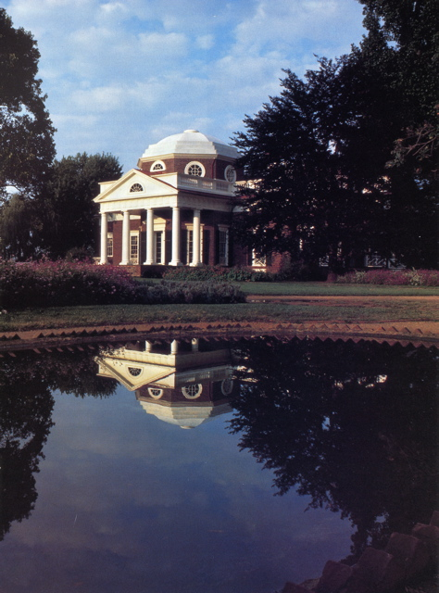
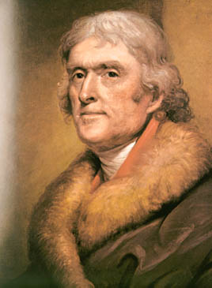
The Jeffersonian Era

Slide 2
Democratic- Republican Party
1st 2-party system = Federalists vs. Democratic-Republicans
Sometimes called the Republicans (don’t confuse with modern Republicans)
Organized by Thomas Jefferson and James Madison
States' rights (KT and VA Resolutions)
An agrarian (agricultural) and commercial economy
Strict constructionism
Friendship with France

Slide 3
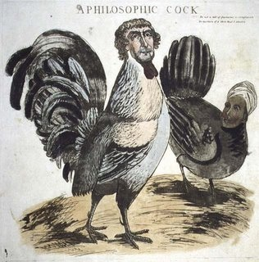
Election of 1800
1
8
0
0
A thief
A coward
“a mean-spirited, low-lived fellow, the son of a half-breed Indian squaw, sired by a Virginia mulatto father.”

Slide 4
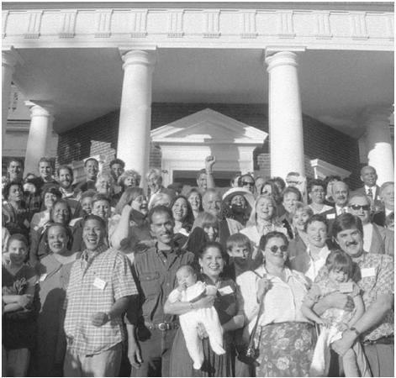
Sally Hemings
The descendants of Sally Hemings at a family reunion (1999)

Slide 5
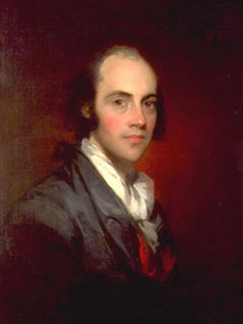
Election Results
1
8
0
0
Both Jefferson and Aaron Burr received 73 votes in the electoral college.
The Constitution required that the House of Representatives, voting by states, choose between them.
Jefferson was elected.
Twelfth Amendment

Slide 6
“Revolution” of 1800
No fanfare at inauguration
Informal White House
Non-hierarchical seating at official dinners
Sends messages to Congress
Pardons “martyrs” of Alien & Sedition Acts
Naturalization law of 1802
1st inaugural address: “We are all Republicans…”
Patronage - “few die, none resign”
Funding of debt, bank, protective tariff
Allows excise tax, Alien & Sedition Acts to expire

Slide 7
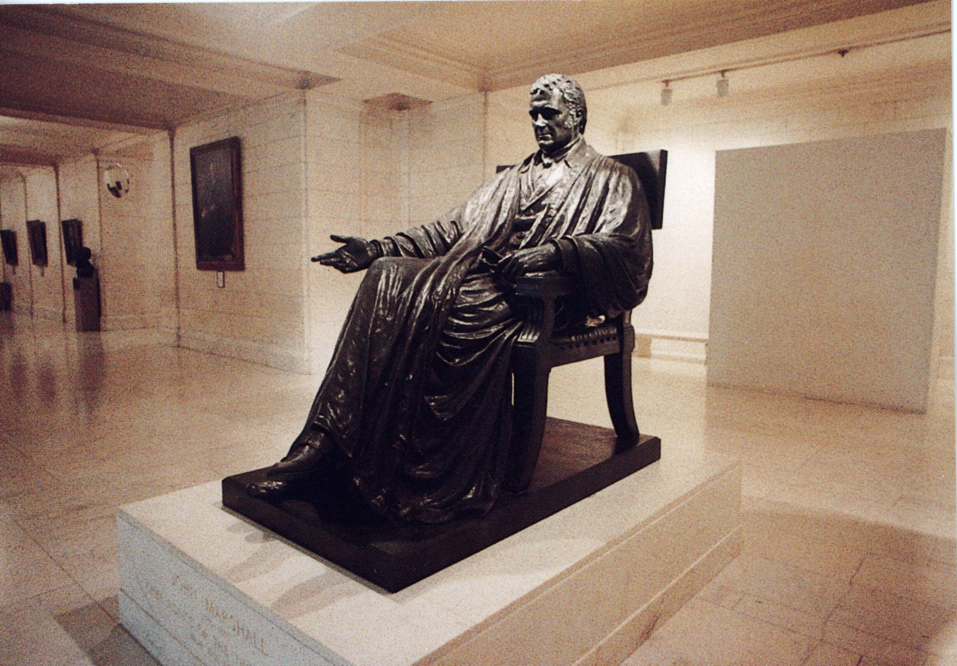
John Marshall
1
8
0
1
Chief justice of the United States from 1801 to 1835.
A Federalist
His court issued several significant decisions including those in Marbury v. Madison and McCulloch v. Maryland.
His decisions generally expanded the power of the national government and promoted economic development.
His rulings consistently upheld the sanctity of contracts and the supremacy of federal legislation over the laws of the states.

Slide 8
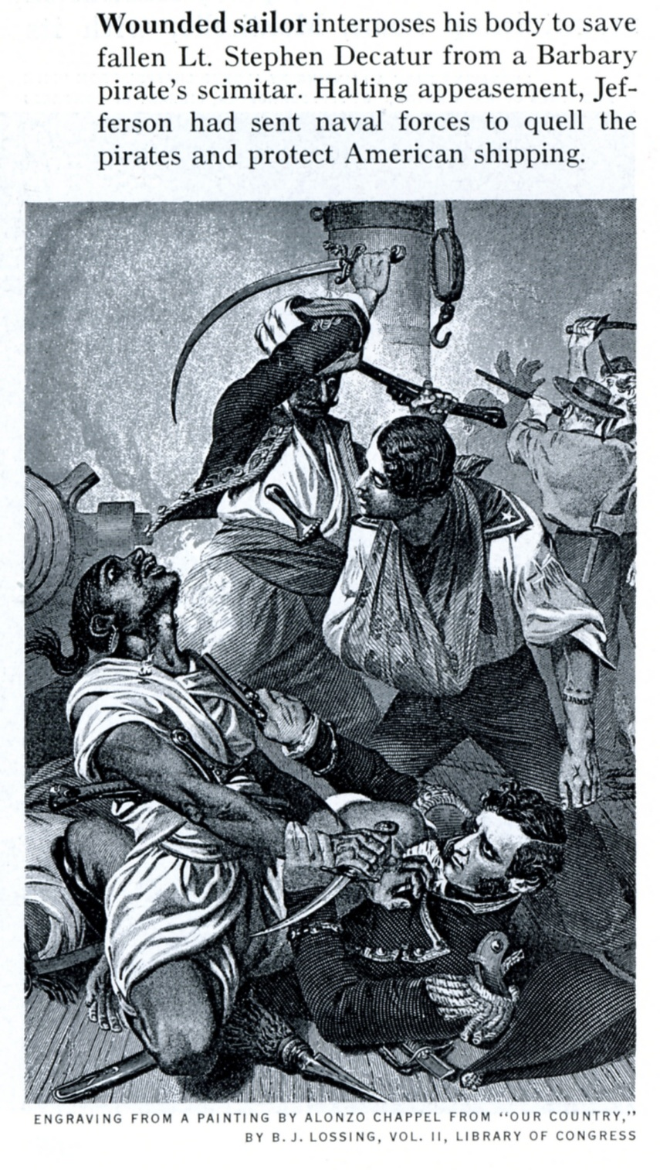
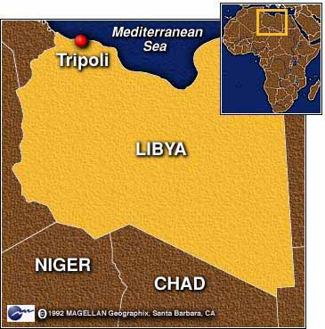
TJ’s Foreign Policy
Reduction of military
“peaceful coercion”
Barbary pirates (“from the halls of Montezuma to the shores of Tripoli”)

Slide 9
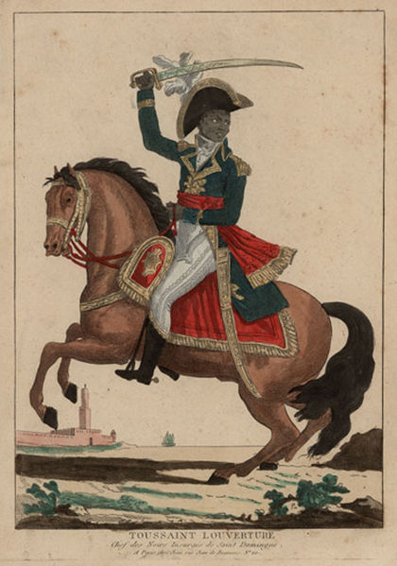
Louisiana Purchase
1
8
0
3
French control of New Orleans and Mississippi
Influenced by slave revolt in Santo Domingo (Toussaint L’Ouverture)
Napoleon Bonaparte decides to focus on Europe

Slide 10
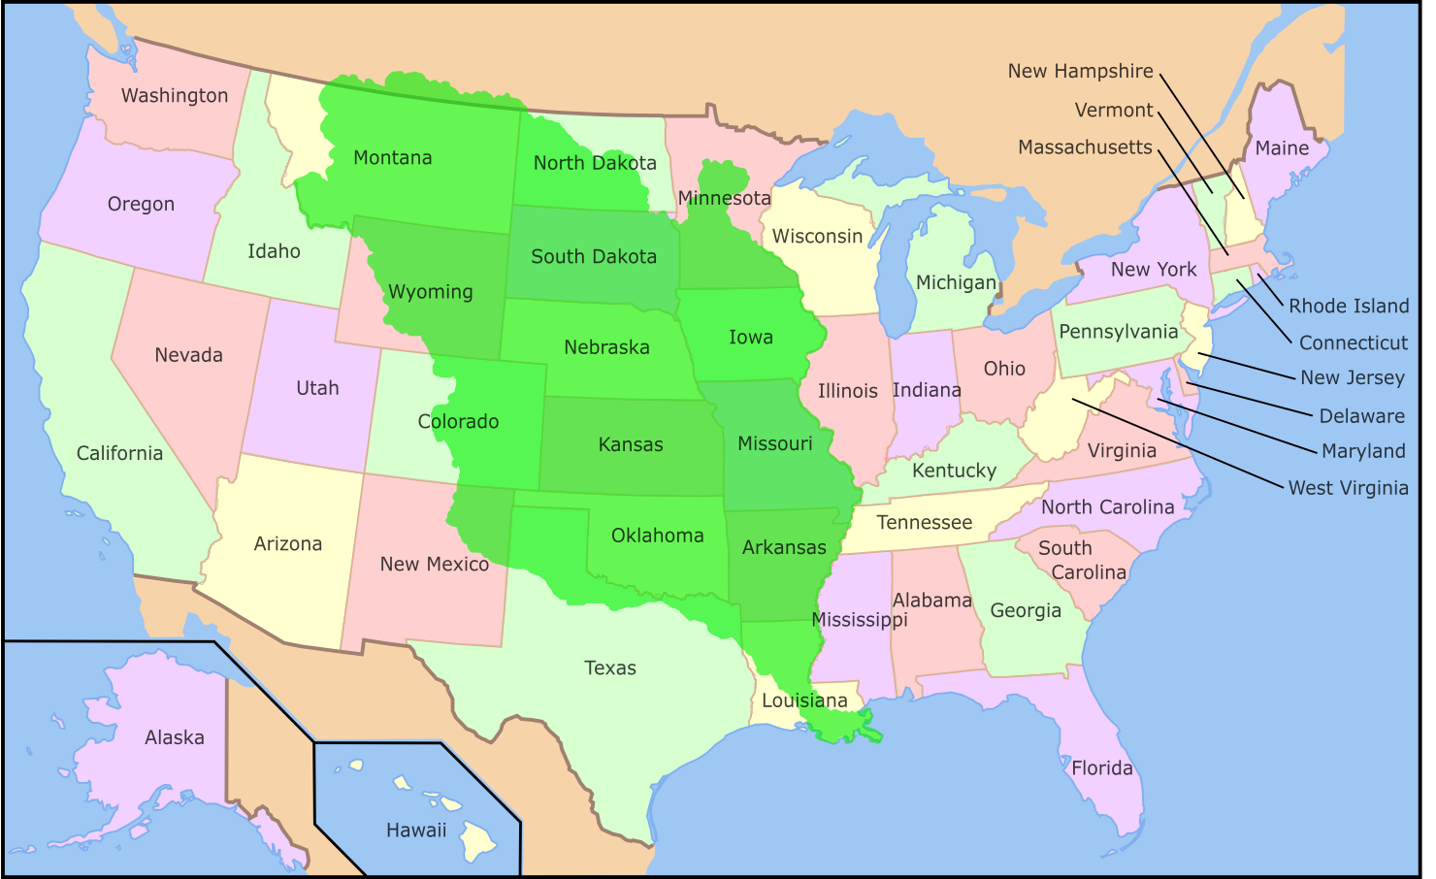
Louisiana Purchase
1
8
0
3
828,000 square miles
$11,250,000 plus cancellation of French debts
Doubles the size of the U. S.

Slide 11
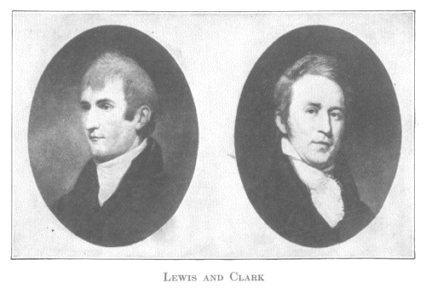
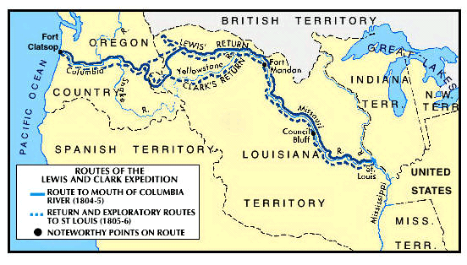
Lewis and Clark
1803
1806
Jefferson commissions Meriwether Lewis and William Clark to explore Louisiana Territory and beyond to the Pacific Coast
Their expedition (1803-1806) brings back wealth of data about the country and its resources

Slide 12
“Empire of Liberty”
Thomas Jefferson’s term
Time eventually destroys empire
Unending new space in which to expand postpones decline
Land is the great equalizer. No overpopulation = no class divisions

Slide 13
strict constructionist?
Does the Constitution specifically give the government the authority to purchase new lands?
Was Jefferson a hypocrite?
Is it possible that the presidency changes people’s perspective?
Is strict constructionism a valid philosophy?

Slide 14
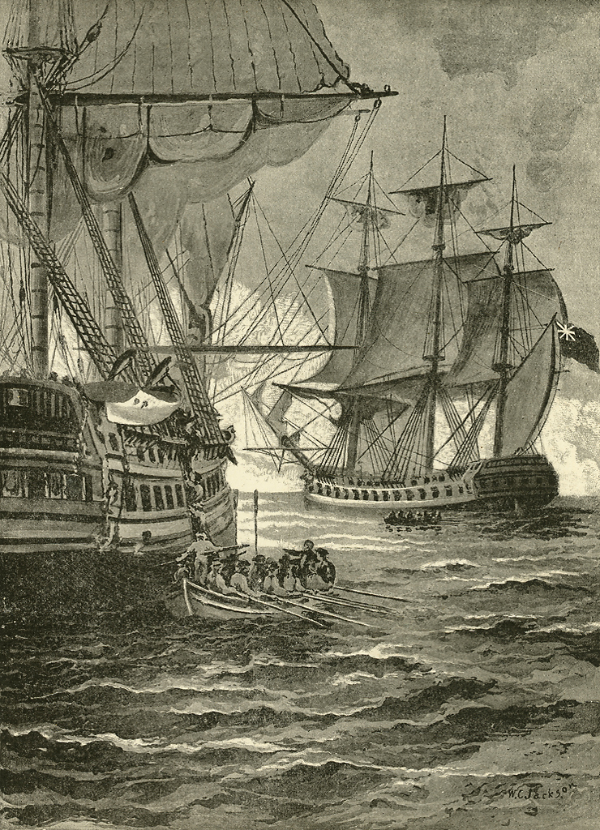
British Orders in Council
1
8
0
7
Series of edicts blockading most European ports and barring from them all foreign vessels that did not first stop at a British port to pay customs
The orders ignored America's claims to neutral rights.

Slide 15
Chesapeake-Leopard Incident
1
8
0
7
The United States naval vessel Chesapeake was fired upon and boarded by British officers from the Leopard
Four sailors were impressed into service for the Royal Navy.
Provoked clamor for war in the United States, but President Jefferson asked Congress for the Embargo Act instead.
impressment

Slide 16
Embargo Act of 1807
1
8
0
7
Provoked by the "Chesapeake" incident
Prohibited all exports from American ports.
Jefferson hoped to pressure Britain and France into recognizing neutral rights,
Embargo damaged the U.S. economy instead and was bitterly resented, especially in New England.
“peaceful coercion”

Slide 17
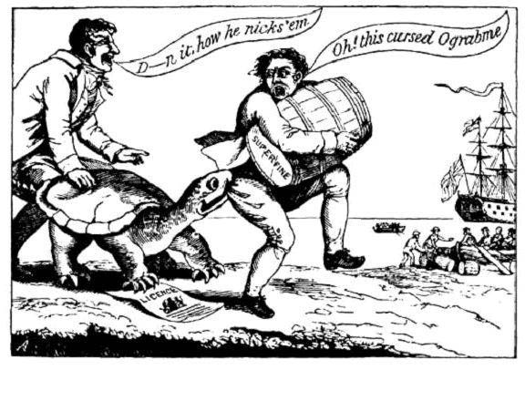
Ograbme
1
8
0
7

Slide 18
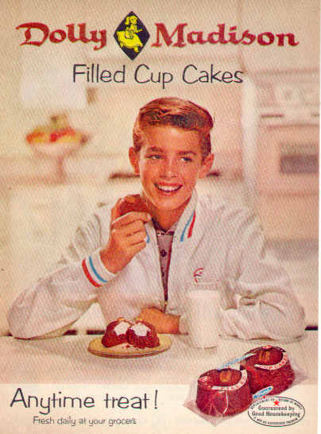
James Madison
1
8
0
9
Author of the Virginia Plan
“Father of the Constitution”
Compiler of the Bill of Rights
Author of the Virginia Resolution
Fourth POTUS
Husband of Dolly Madison

Slide 19
Non-Intercourse Act
1
8
0
9
In 1809, Congress replaced the Embargo Act with the Non-Intercourse Act.
It forbade American trade only with Britain and France
It authorized the president to end non-intercourse with either nation if it stopped violating America's neutral rights.
“peaceful coercion”

Slide 20
Macon’s Bill No. 2
1
8
0
9
Replaced the ineffective Non-Intercourse Act.
Removed all restrictions on commerce with France and Britain, but it authorized the president to reapply non-intercourse to either power if one of them ceased violating American neutral rights.
“peaceful coercion”

Slide 21
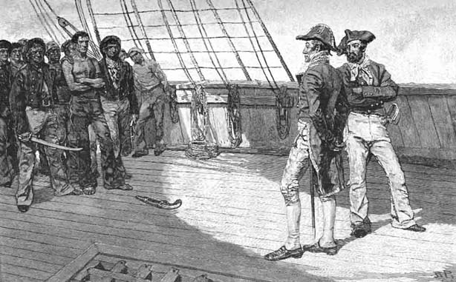
impressment
1
8
1
2
The British navy used press gangs to commandeer manpower for naval service.
During the Napoleonic Wars, British captains impressed seamen from neutral vessels, even naturalized American citizens.
America's sense of national honor was outraged
Impressment became a cause of war in 1812.

Slide 22
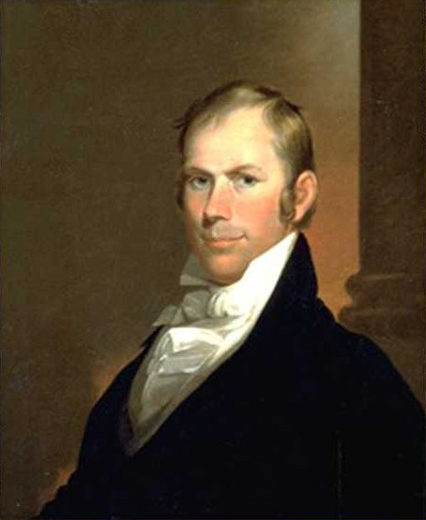
War Hawks
1
8
1
1
Speaker of the House, Henry Clay
Young congressional leaders from South and West
Called for war against Great Britain in 1811 and 1812
Tired of Jefferson and Madison’s “peaceful coercion”
Saw war as the only way to defend the national honor and force the British to respect America's neutral rights.
“hawks and doves”

